Slide 1

Fake Job Prediction
Group 7
Bhakti Raichura
Khushee Thakker
Shreya Srirama
Varsha Srinivasan

Slide 2
Problem Statement
Develop a classifier to distinguish between real and fake jobs using machine learning algorithms like KNN, Naive Bayes, Random Forest, Decision trees etc.
Use data collected from Kaggle and web scrapped from Indeed.com for analysis
Use of Term Frequency-Inverse Document Frequency (TF-IDF) and Bag-of-Words (BoW) for analysis and model development

Slide 3
Motivation
In today’s world of constant unemployment, people turn to online job postings to find new jobs
Economic stress and impact of covid have significantly reduced jobs in the market. This imbalance in the market attracts fake job posters to scam the job finder
Fake job postings are posted in order to steal personal details. The scammers provide users with a very lucrative job opportunity and later ask for money in return
This project aims to create a classifier that will have the capability to identify fake and real jobs using Machine learning techniques

Slide 4
Literature Survey
Paper Name | Dataset Used | Models Used | Result
Aashir Amaar et al., (2021) Detection of Fake Job Postings by Utilizing ML and NLP Approaches | Fake Job postings- Kaggle | Random Forest, Logistic Regression, SVM, ETC, KNN, MP | 99.9%, using TF-IDF features and the ETC classifier with the ADASYN technique
Ranparia et al., (2020) Fake job prediction using sequential network | The Employment Scam Aegean Dataset (EMSCAD) | Global Vector Model (GloVe), Sequential Neural Networks using Sigmoid and Relu activation functions | For 138 non-fraudulent job posts they achieved 98.38% accuracy (2 fraudulent predicted)
Nasser, & Alzaanin (2020) Machine Learning and Job Posting Classification: A Comparative Study | Real / Fake Job Posting Prediction - Kaggle | Multinomial NB, SVM, Decision Tree, KNN, and RF | RF and KNN have highest, 97.8 and 98.2 respectively
Dutta & Bandyopadhyay (2020) Fake Job Recruitment Detection Using Machine Learning Approach | [Real or Fake] Fake Job Posting Prediction | NB, Decision Tree, MP, KNN, AdaBoost, Gradient Boost and Random Tree | Random Forest Classifier to be best with 98.27% accuracy.

Slide 5

Framework

Slide 6
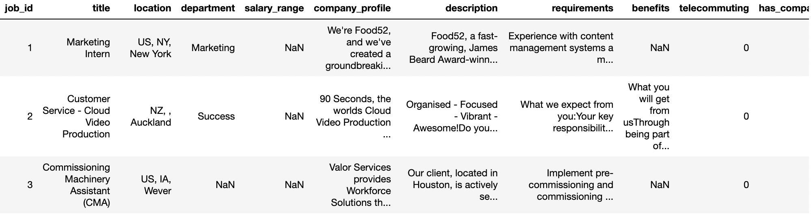
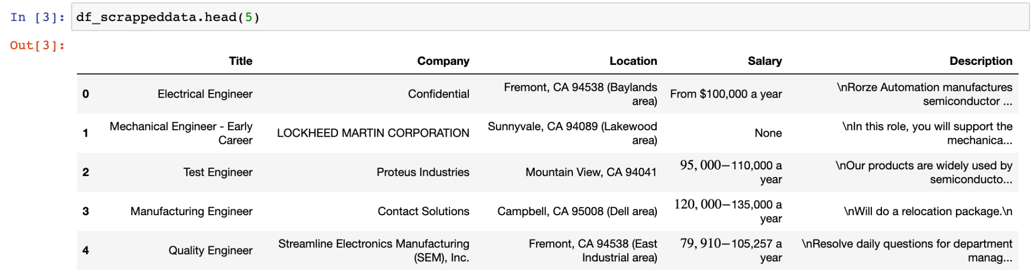
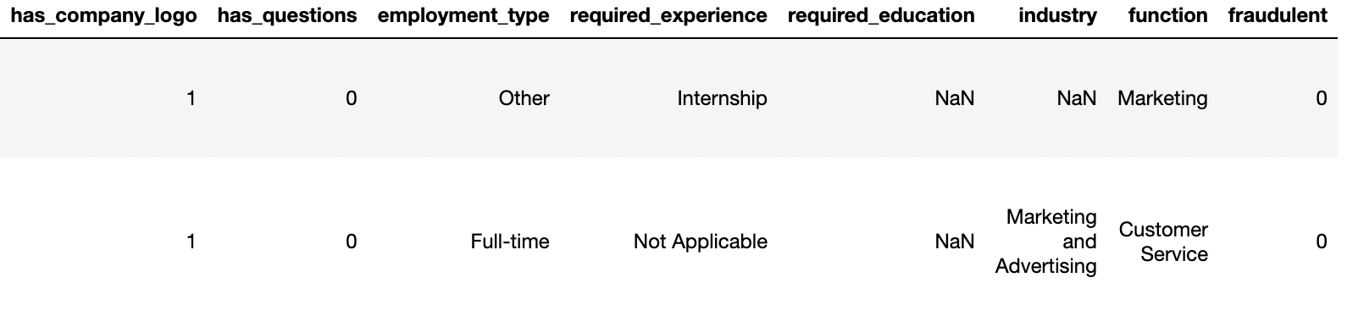
Data Collection
Job postings categorized as ‘Real’ and ‘Fake’ are collected from sources in two ways
Kaggle
Web-Scraping

Slide 7

Data Exploration
EDA
Missing Value Check
Detecting Outliers
Null value check for every column is performed and handled
Outliers in the numerical column to know if noise is present in data
Uni & Bivariate Analysis
Feature Engineering
Understanding the values distribution and relationship with others
Dropping unwanted attributes and retaining important columns

Slide 8
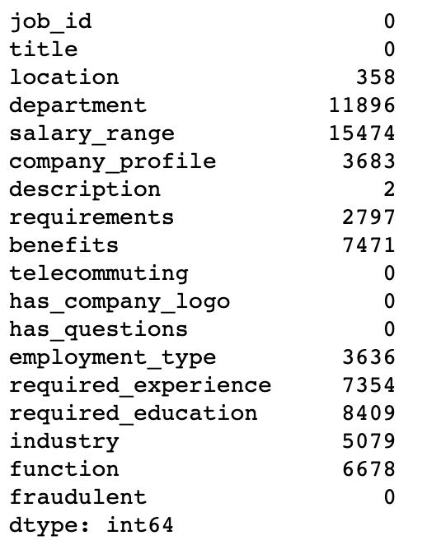
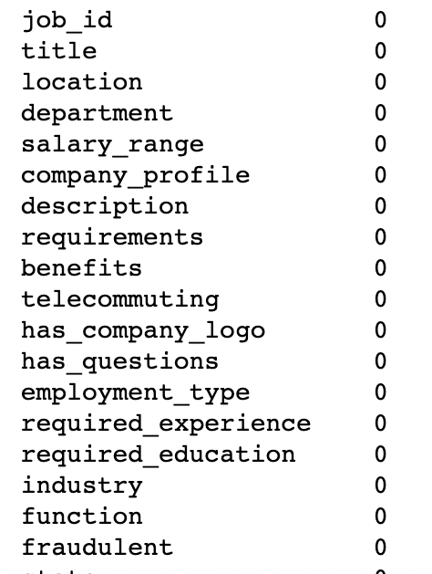
Data Exploration
Missing Values Check & Handling

Slide 9
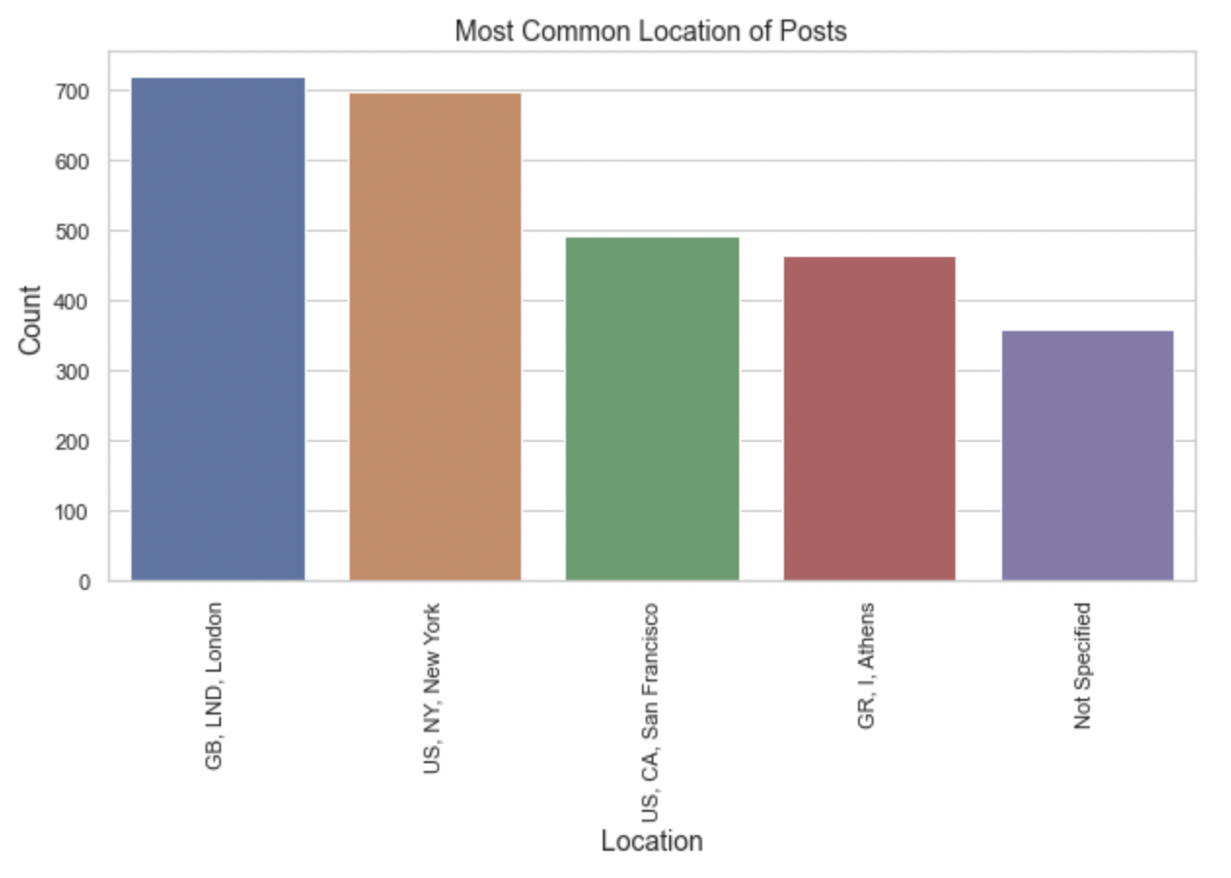
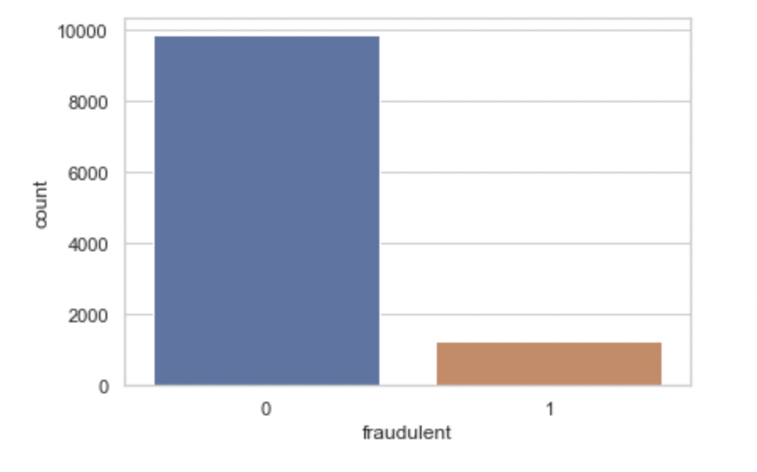
Data Exploration
Univariate Analysis
Checking the locations of the job posts
Exploring the target feature: fraudulent

Slide 10
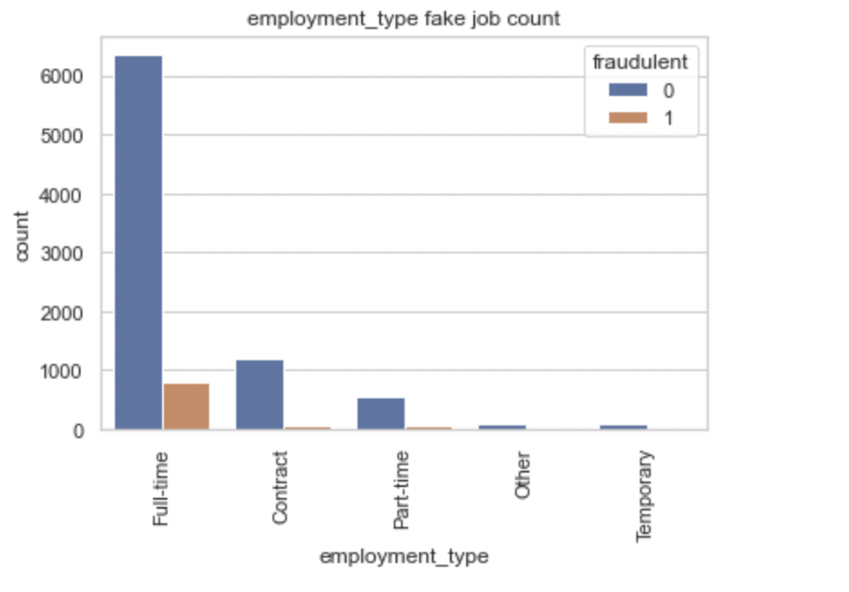
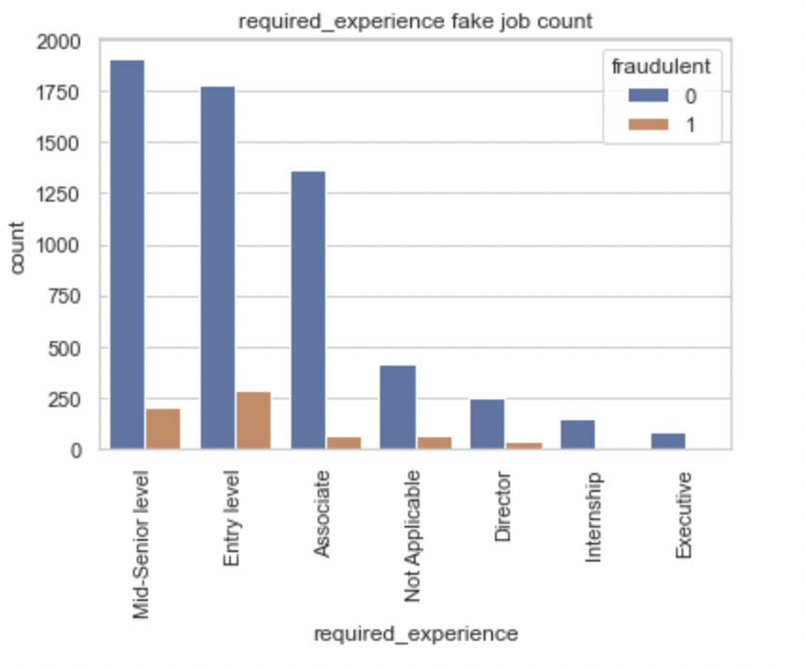
Data Exploration
Bivariate Analysis
Fake jobs posted w.r.t employment type
Fake jobs posted w.r.t required experience

Slide 11
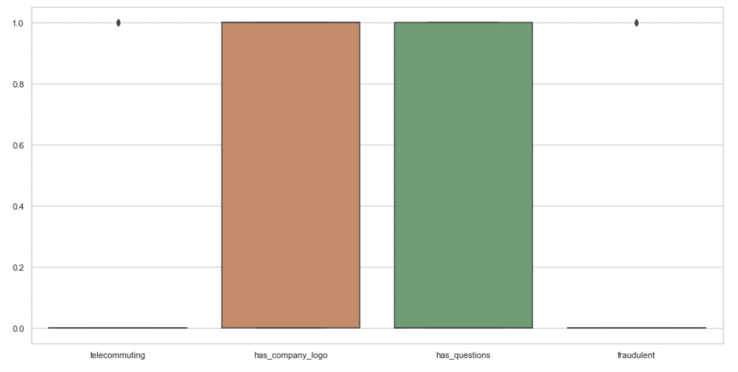
Data Exploration
Valid outliers in the features indicating less data for fake job postings
Detecting Outliers

Slide 12
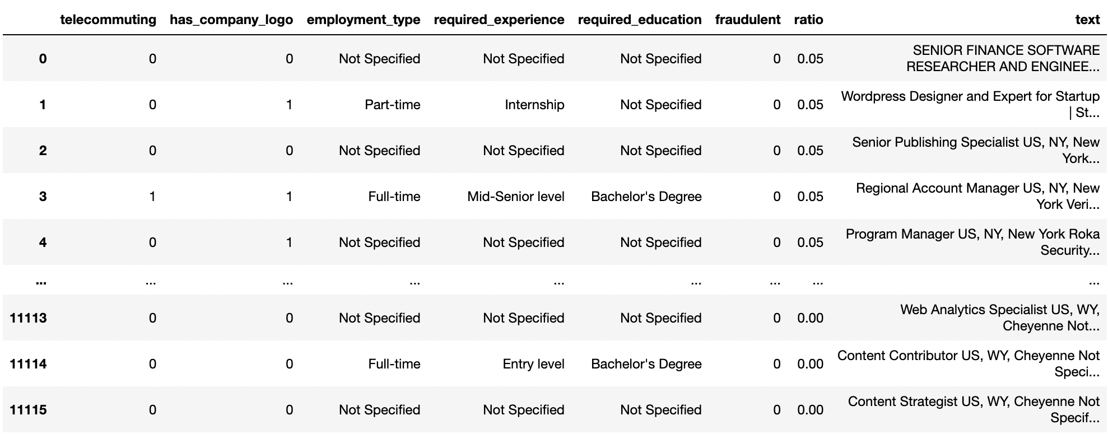
Data Exploration
Selecting only the key features that supports our target feature
Feature Engineering

Slide 13
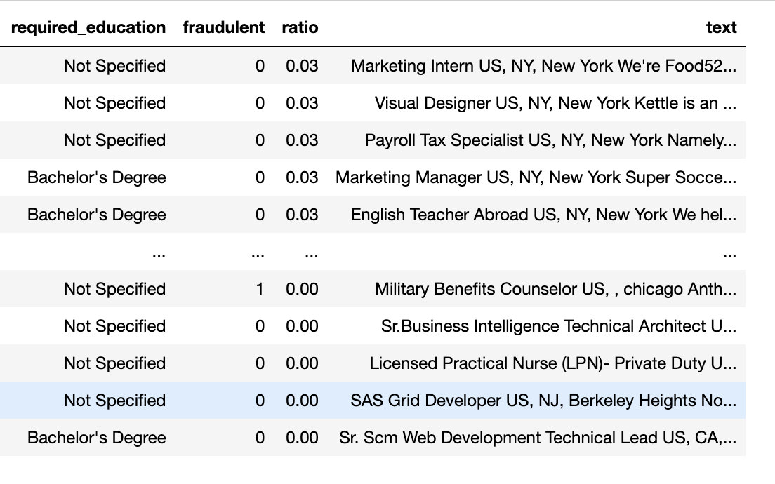
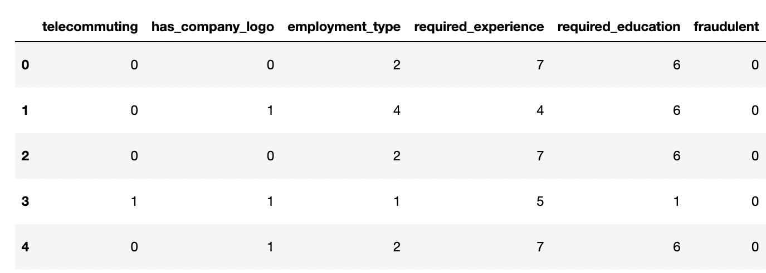
Data Transformation
Data Splitting
Divide the data into categorical and non-categorical features to support data modeling
Combine all textual non categorical features and other categorical features over threshold of 20 unique values into a single “text” column to be used for text processing
Label Encoding
Performed label encoding for categorical data features to make the data machine readable
Merged encoded columns back with the “text” column

Slide 14
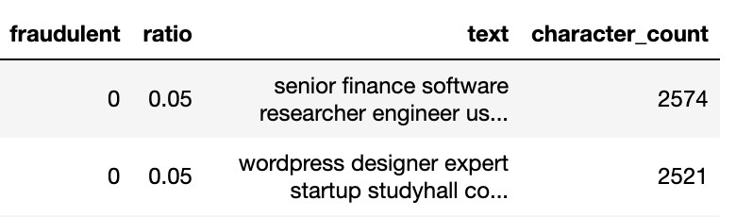
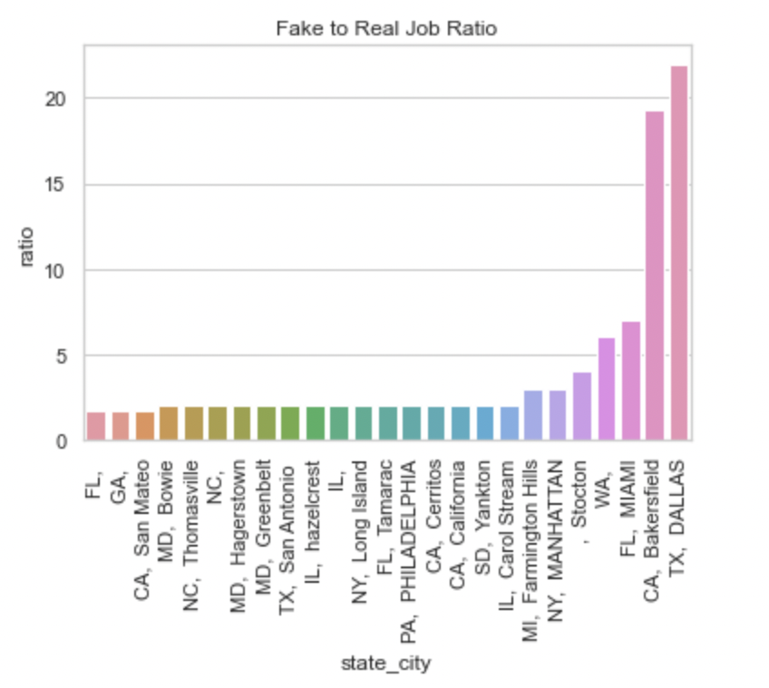
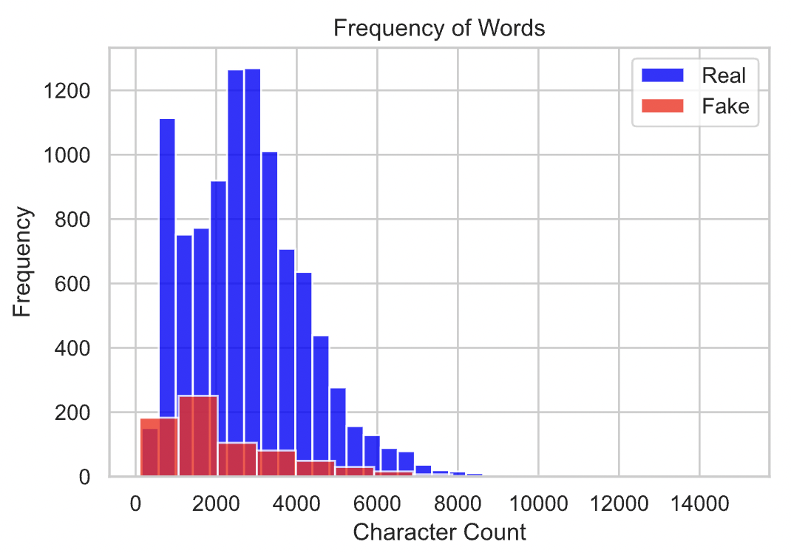
Derived Data

Slide 15


Data Transformation
Fraudulent job word cloud
Real job word cloud

Slide 16
Text Preprocessing
Transforming text into clear and concise format using NLTK (Natural Language Toolkit)
01
02
03
Tokenization
Lowering text
Remove numbers and punctuations
06
05
04
Lemmatization
Stopwords
Remove Non-ASCII

Slide 17
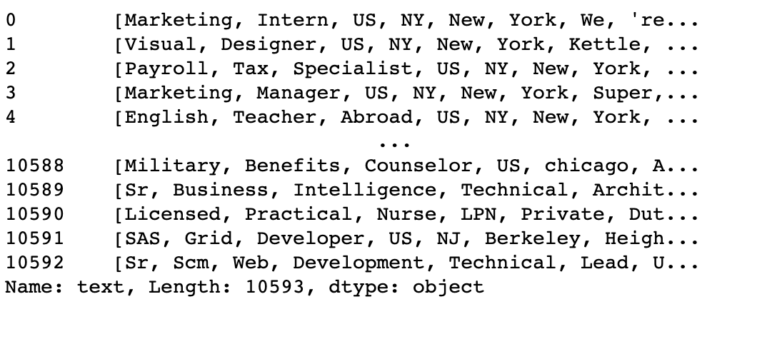
Text Preprocessing
Tokenization
The text is split into smaller units.
Smaller units that can be more easily assigned meaning
We can use word tokenization to assign each word to different tokens

Slide 18
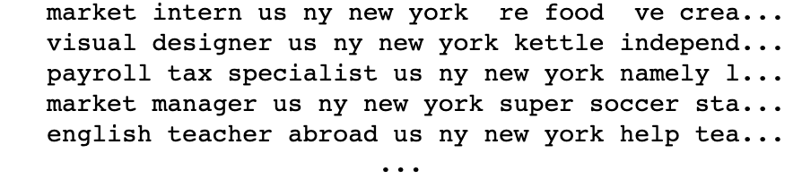
Text Preprocessing
Lowering Text
Remove Punctuations
It helps to get rid of unhelpful parts of the data, i.e. noise
Converts all characters to lowercase
String library of Python contains predefined list of punctuations such as ‘!”#$%&'()*+,-./:;?@[\]^_`{|}~’

Slide 19
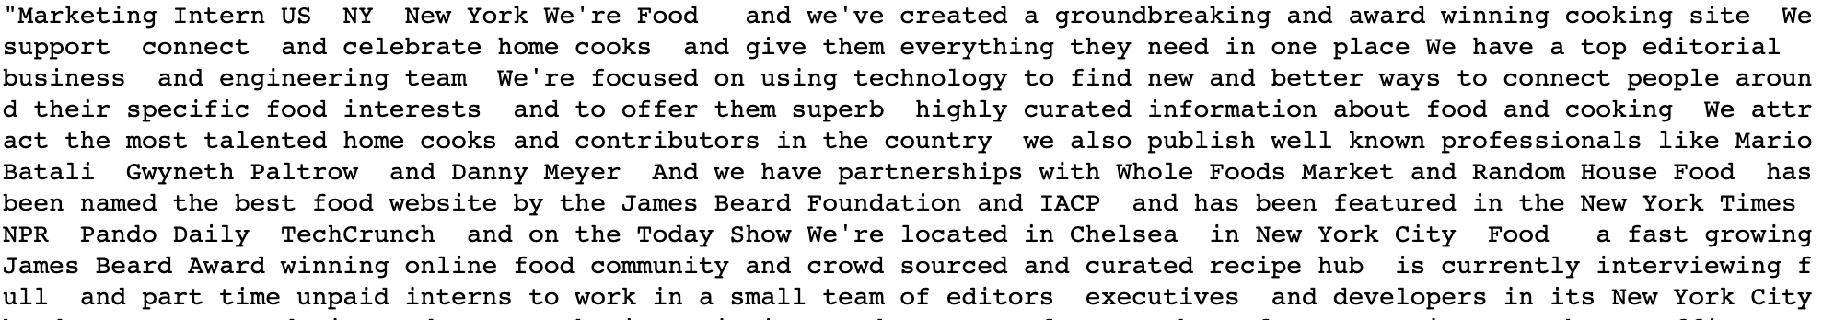
Text Preprocessing
Remove non-ASCII
Remove Numbers
Non-ASCII not processed by ML algorithms.
Removing non-ASCII using Regular expression
Number doesn’t hold any vital information in the text here.
Numbers are removed using regular expressions

Slide 20
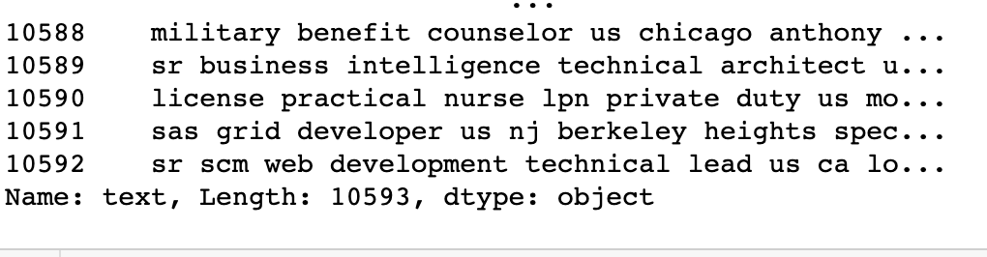
Text Preprocessing
Remove Stopwords
Lemmatization
Stopwords are the commonly used words and are removed from the text as they do not add any value to the analysis.
These words carry less or no meaning.
It stems the word without meaning loss.
Pre-defined dictionary that stores the context of words

Slide 21
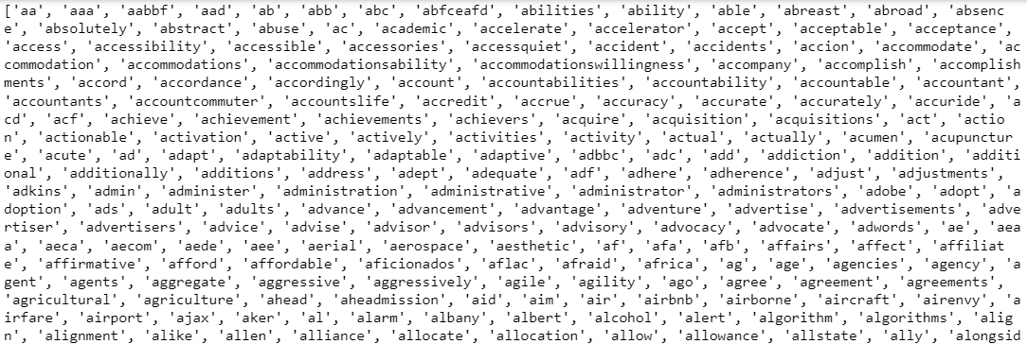
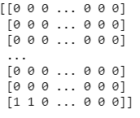
CountVectorizer
Python scikit-learn library provides the tool Count Vectorizer. It is used to convert a given text into a vector based on the number of times that each word appears across the full text.

Slide 22
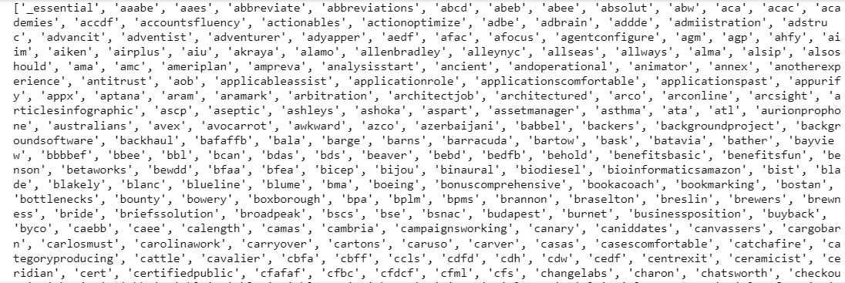
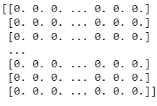
Term Frequency Inverse Document Frequency -TFIDF
TFIDF works by proportionally increasing the number of times a word appears in the document while balancing it out by the number of other documents it appears in

Slide 23
CountVectorizer Vs TFIDF
Logistic Regression
Countvectorizer
TFIDF
98%
88%

Slide 24
Modeling
MODEL | Accuracy for Text | Accuracy for Numerical
Multinomial Naive Bayes | 0.935 | 0.893
Bernoulli Naive Bayes | 0.904 | 0.886
Support Vector Machine | 0.979 | 0.807
Random Forest | 0.991 | 0.926
Decision Tree | 0.981 | 0.913
K- Nearest Neighbors | 0.934 | 0.924
AdaBoost | 0.943 | 0.914

Slide 25
Hyperparameter Tuning
Using GridSearchCV
Grid Parameter:
Min_samples_split: 1,2,3,4
Min_samples_leaf: 1,2,3
Max_depth: 4,6,12,18
N_estimators: 40,50,100
Textual Data
Numerical data
Max_depth : 18
Max_depth : 18
min_samples_leaf : 1
min_samples_leaf : 1
min_samples_split: 2
min_samples_split: 2
N_estimators : 50
N_estimators : 100
94.83%
96.35%

Slide 26
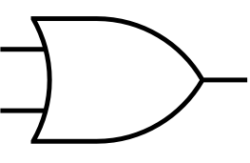
Prediction Aggregation
Textual Data predicted value
OR
Final predicted value
Numerical data predicted value
97.1%
 |  | Predicted
 |  | Real | Fake
Actual | Real | 1937 | 35
 | Fake | 31 | 221
Confusion
Matrix

Slide 27

Conclusion
In our project, we collected job postings data, and performed EDA to understand the data better.
Later we split the data into text and categorical data and performed data preprocessing
Data modelling was done using 7 machine learning models
Random Forest gave better accuracy for both textual and numeric data. Total accuracy of 97.1%
This study can thus help job-seekers from falling prey to job scams

Slide 28
Thank You

